Slide 1
Principles & Practice In End of Life Care (non-registered practitioners) Day 1 23rd April 2019
Do not hesitate to contact. I work part time, but will reply as soon as possible.

Slide 2
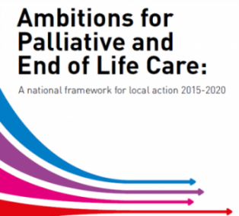
Palliative care / end of life care
What do these words really mean?
What do they mean to healthcare staff?
What do they mean to residents & their families?
Definitions – Check out appendix A of
Ambitions for Palliative & End of Life Care
http://endoflifecareambitions.org.uk/

Slide 3
Thinking about the words we use (SCIE & NCPC 2014)
Understand the impact of the terms used.
Try to explain in plain English, rather than unfamiliar terms.
Whatever terms used, always check understanding.
Consider your communication skills (speak in a kind & caring way to all).
Film from SCIE & NCPC - worth another look!
https://www.youtube.com/watch?v=nokDDalo_gM
https://www.scie.org.uk/socialcaretv/video-player.asp?v=palliative-care-or-end-of-life-care

Slide 4
Ambitions for Palliative & End of Life Care
‘End of life care is care that affects us all…’ (NPEoLCP 2015)
Each person is seen as an individual
Each person gets fair access to care
Maximising comfort & wellbeing
Care is coordinated
All staff are prepared to care
Each community is prepared to help
http://endoflifecareambitions.org.uk/
What about putting up a poster?

Slide 5
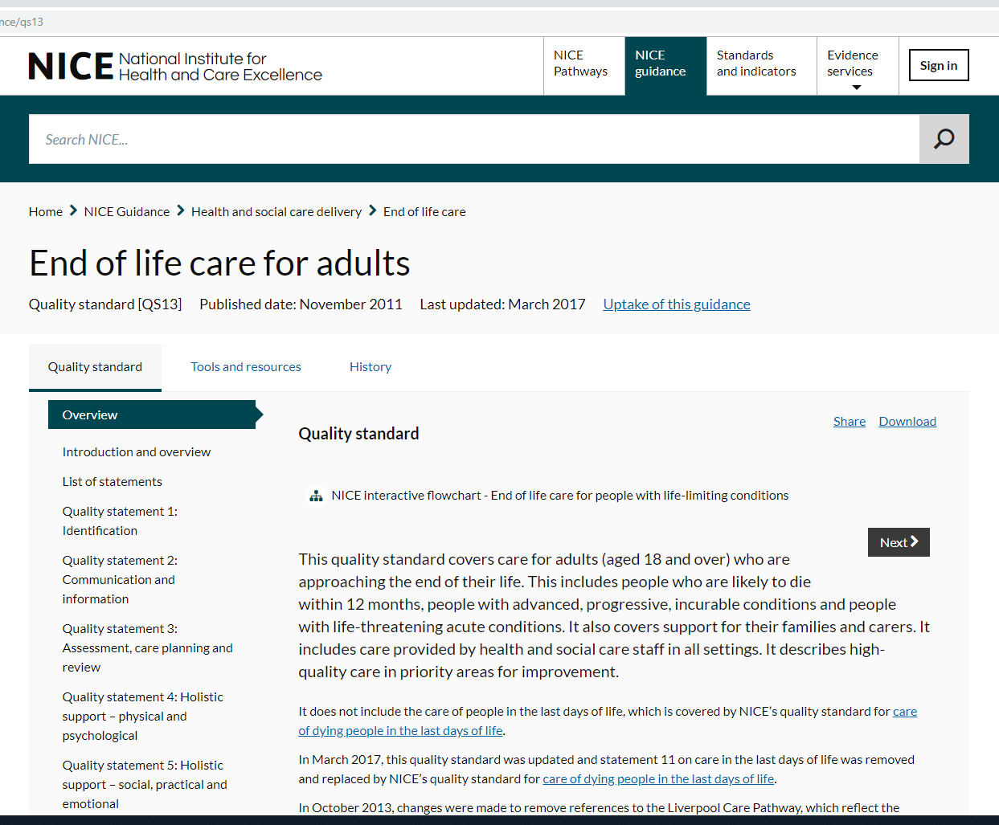
NICE Guidance National Institute for Health & Care Excellence
Take a look!
https://www.nice.org.uk/guidance/qs13
https://www.nice.org.uk/guidance/qs144

Slide 6
Web site aimed at raising awareness about dying death & bereavement. Think of where you could put a poster or use some leaflets.
Check out Dying Matters website
www.dyingmatters.org

Slide 7
Dying Matters Week 13^{th -} 19th May
Look at what Pilgrims
Education Dept. are up to!
Come & join us or book onto one of the events

Slide 8
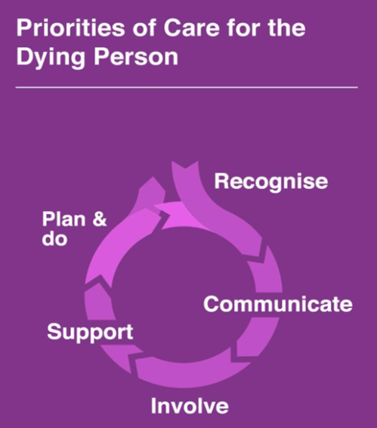
Last days or hours of life We will be exploring this further in week 5, but take a look before
Priorities for Care of the Dying Person
Duties & Responsibilities of Health & Care Staff
Following the demise of the Liverpool Care Pathway; these 5 priorities are the way forward to ensuring best practice in care for the dying person & their family (significant others).
Visit NHS Improving Quality Archive
Link to handy reference guide:
http://webarchive.nationalarchives.gov.uk/20160805125329/http://www.nhsiq.nhs.uk/media/2483136/pfcdp-leaflet2.pdf
What about putting up
this poster?

Slide 9
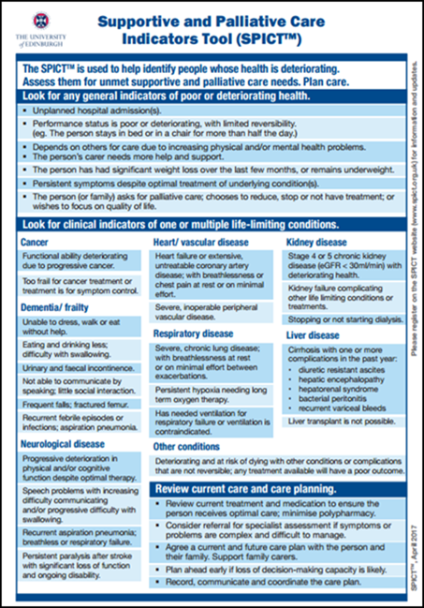
Tools to help identify deteriorating health
The Surprise Question
‘Would I be surprised if this person died in the next year?’
This could be a useful prompt to consider advance care planning discussion.
However this question is just a starting point & should not be used alone.
(Downer et al 2017)
The SPICT tool can help us to identify people with declining condition.
Notes:
Any one using these?
Reminder to those doing GSF also the PIG tool. Proactive Identification Guidance (Just hand out to those using this as a reminder!)
Laminated SPICT tools
This updated 6th edition of the GSF PIG, renamed as Proactive
Identification Guidance and formally known as Prognostic Indicator
Guidance, aims to enable the earlier identification of people nearing the
end of their life who may need additional supportive care. This includes
people who are nearing the end of their life following the three main
trajectories of illness for expected deaths – rapid predictable decline
e.g. cancer, erratic decline e.g. organ failure and gradual decline e.g.
frailty and dementia. Additional contributing factors when considering
prediction of likely needs include current mental health, co-morbidities
and social care provision.
SPICT have a useful APP!

